Slide 1
Accelerating LLM and SLM with Fine-Tuning: A Live Coding Tutorial for Evaluating Accuracy, Latency, and Cost To Find The Best Model
Daniel Taube

Slide 2
Is picking the best model for the task is important?

Slide 3
Is Accuracy, Latency, and Cost being the important factors for choosing the model?

Slide 4
If you answer YES you are in the right place

Slide 5
Session Overview
Why Evaluate and Fine-tune LLMs?
LLM 1o1
Fine-tuning Pipeline Overview
Measuring Performance
Data
To the code
Real World

Slide 6
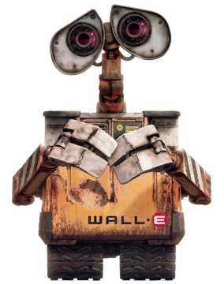
Why Evaluate and Fine-tune LLMs?
Agents!

Slide 7

Search/Thinking
Action/Function calling
Summary/Review

Slide 8
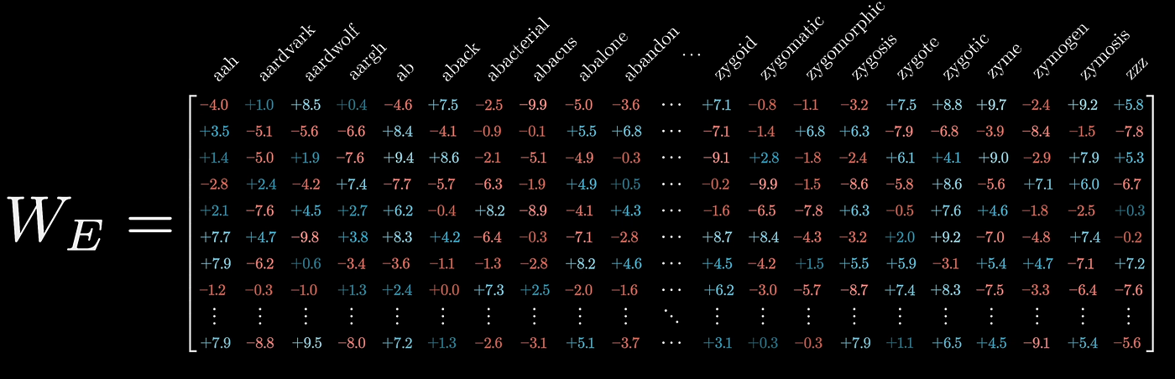
LLM 101

Slide 9
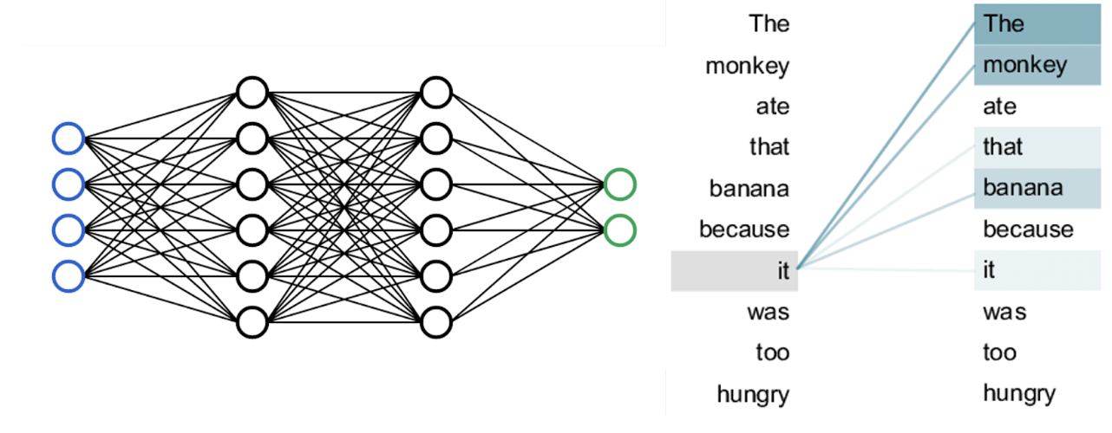
Classifier

Slide 10
Fine-tuning Pipeline Overview
Training Data
Testing Data
Fine Tune model
Language model
Evaluation Metrics

Slide 11
Measuring Performance
LLM
Accuracy
Fine tune LLM
Latency
SLM
Cost
Fine tune SLM

Slide 12

Data

Slide 13
A positive review:
In a near future, the ordinary man above any suspicious from the suburb Morgan Sullivan (Jeremy Northam) is hired by Digicorp, a huge corporation, to be assigned as a spy and steal secrets from their competitors, Sunways. Along his training, Morgan is brainwashed, assumes a new identity of Jack Thursby and travels to boring lectures. In one of them, he is approached by the beautiful and mysterious Rita Foster (Lucy Liu), who advises him that nothing is how it seems to be. Morgan acknowledges a new reality, where he does not know who can be trusted.<br /><br />The unknown "Cypher" was a great surprise for me. This movie has not been released in Brazil, but the engaging and exciting story is quite complex, with many plot points, and with great screenplay, direction and performances. In the very last twist, I recalled Arnold Schwarzenegger's "Total Recall". This movie certainly deserves to be watched more than once, and I really did not like the last scene, when the independent spy disposes the disputed disc in the sea. In only know the director Vicenzo Natali from the fantastic "Cube", and this second work I see is also stunning. My vote is eight.<br /><br />Title (Brazil): Not Available

Slide 14
A Negative review:
It really impresses me that it got made. The director/writer/actor must be really charismatic in reality. I can think of no other way itd pass script stage. What I want you to consider is this...while watching the films I was feeling sorry for the actors. It felt like being in a stand up comedy club where the guy is dying on his feet and your sitting there, not enjoying it, just feeling really bad for him coz hes of trying. Id really like to know what the budget is, guess it must have been low as the film quality is really poor. I want to write 'the jokes didn't appeal to me'. but the reality is for them to appeal to you, you'd have to be the man who wrote them. or a retard. So imagine that in script form...and this guy got THAT green lit. Thats impressive isn't it?

Slide 15
Let's Code!

Slide 16
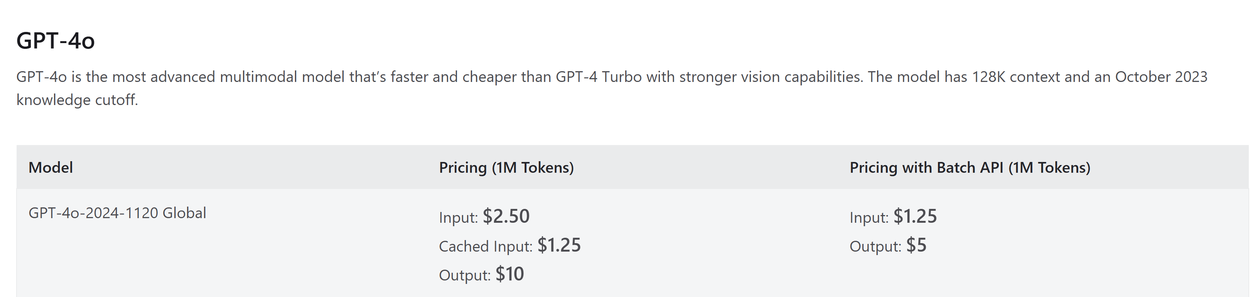
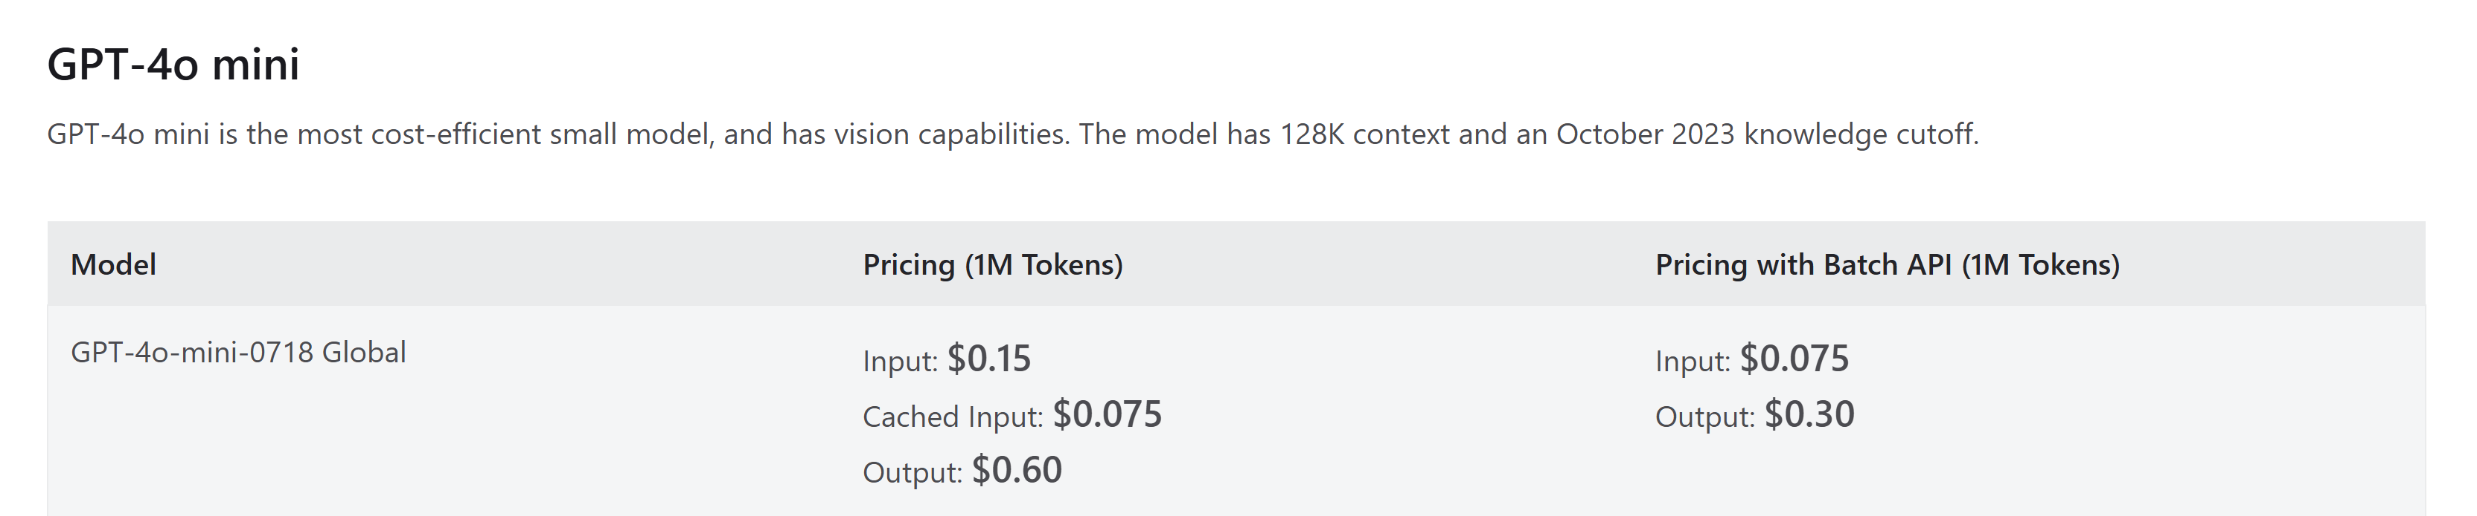
Real World Cost and latency
https://azure.microsoft.com/en-us/pricing/details/cognitive-services/openai-service/#pricing

Slide 17
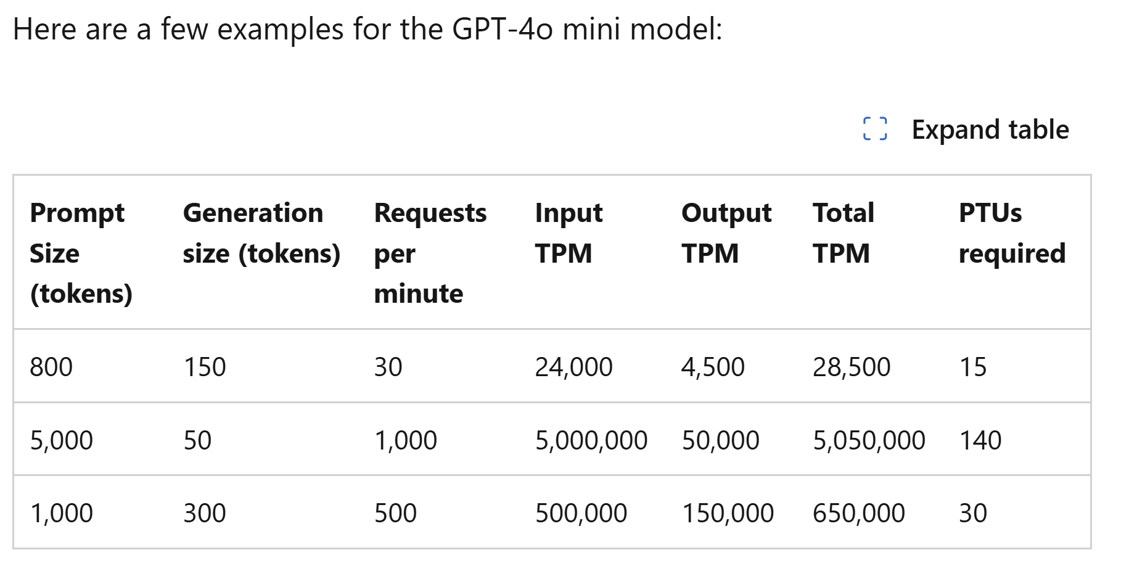
Real World Latency
https://learn.microsoft.com/en-us/azure/ai-services/openai/how-to/latency

Slide 18
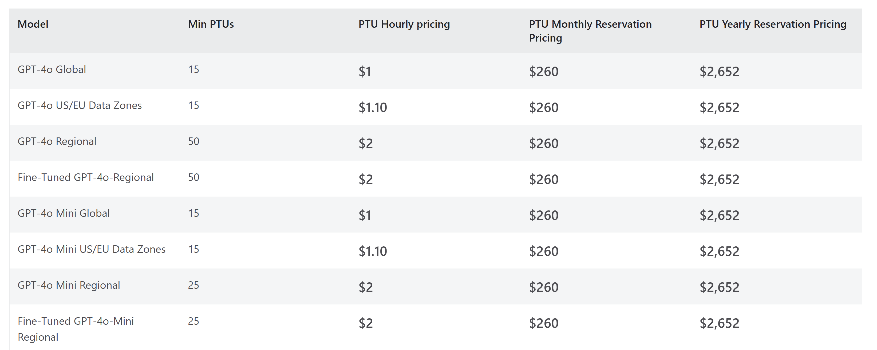
Real World Fine Tune
https://azure.microsoft.com/en-us/pricing/details/cognitive-services/openai-service/#pricing

Slide 19
Thank You!

